Slide 1

Heart Disease Data

Slide 2
Introduction
A type of disease that affects the heart or blood vessels. The risk of certain heart diseases may be increased by smoking, high blood pressure, high cholesterol, unhealthy diet, lack of exercise, and obesity. About 695,000 people died from heart disease in 2021—that's 1 in every 5 deaths. 12. Heart disease costs about $239.9 billion each year from 2018 to 2019. This includes the cost of health care services, medicines, and lost productivity due to death.
Coronary artery disease and stroke account for 80% of CVD deaths in males and 75% of CVD deaths in females. Most cardiovascular disease affects older adults. In the United States 11% of people between 20 and 40 have CVD, while 37% between 40 and 60, 71% of people between 60 and 80, and 85% of people over 80 have CVD

Slide 3
Details of Data
age: Age of the patient
sex: Sex of the patient (1 = male; 0 = female)
chest pain type (4 values)
resting blood pressure
serum cholesterol in mg/dl
fasting blood sugar > 120 mg/dl
resting electrocardiographic results (values 0,1,2)
maximum heart rate achieved
exercise induced angina
oldpeak = ST depression induced by exercise relative to rest
the slope of the peak exercise ST segment
number of major vessels (0-3) colored by fluoroscopy
thal: 0 = normal; 1 = fixed defect; 2 = reversable defect

Slide 4
Main KPIs
Total Number of Male patients: 713 patients
Total Numbers of Female patients : 312 patients
Age: Age is a primary risk factor for heart disease.
Sex: Gender differences in heart disease prevalence.
Resting Blood Pressure (trestbps): An important indicator of cardiovascular health.
Serum Cholesterol (chol): High cholesterol levels can lead to heart disease.
Fasting Blood Sugar (fbs): Elevated blood sugar levels are associated with increased risk.
Maximum Heart Rate Achieved (thalach): Indicator of cardiovascular fitness.
Exercise Induced Angina (exang): Presence of angina during exercise.
ST Depression (oldpeak): Indicator of ischemia.
Number of Major Vessels (ca): Indicates extent of coronary blockage.
Thalassemia (thal): Blood disorder that may affect heart health.

Slide 5
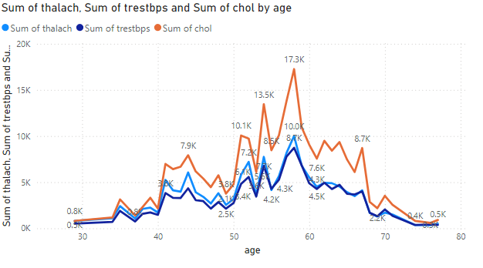
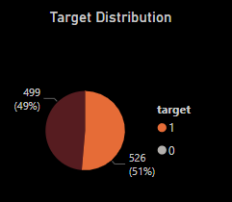
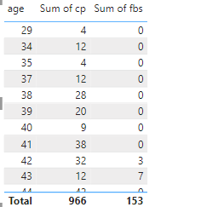
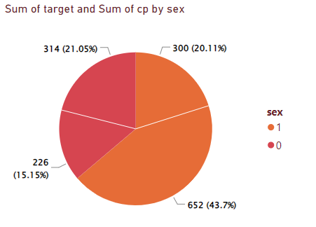
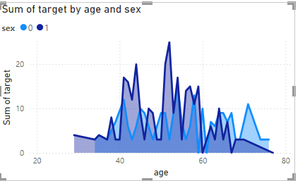

Mock-up Dashboard

Slide 6
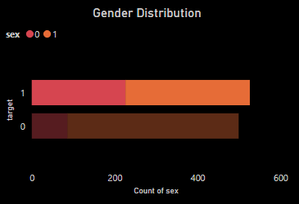
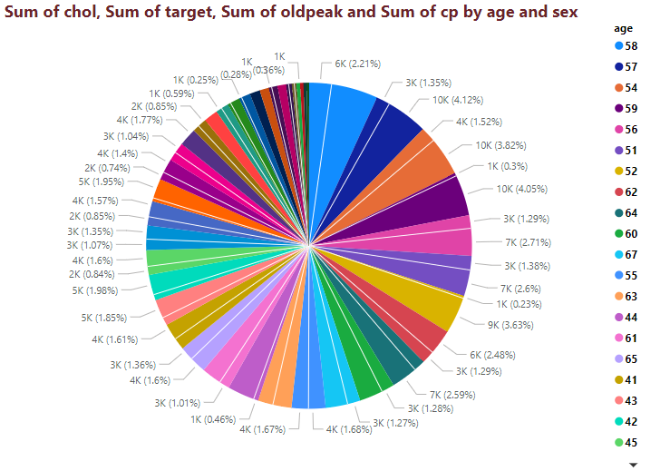
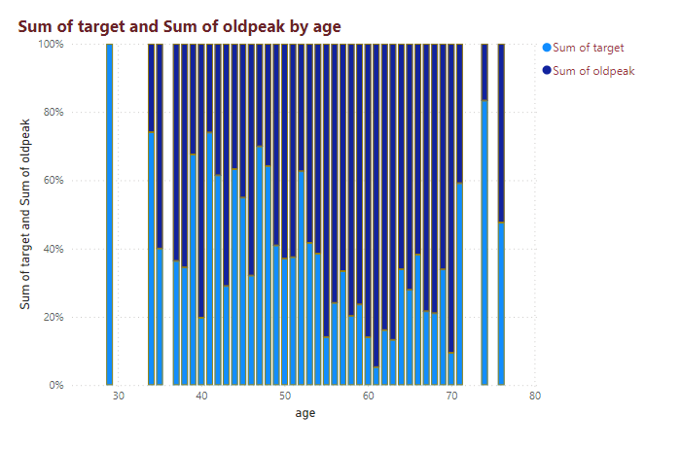
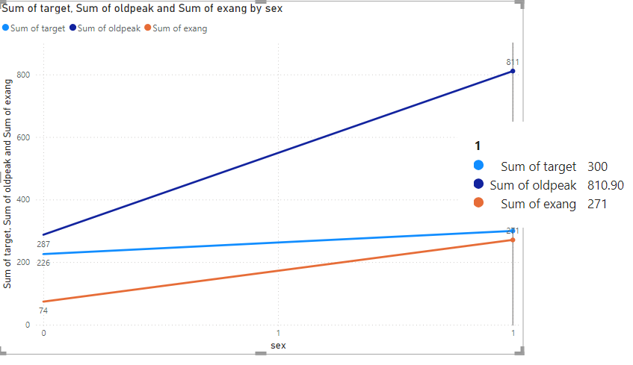
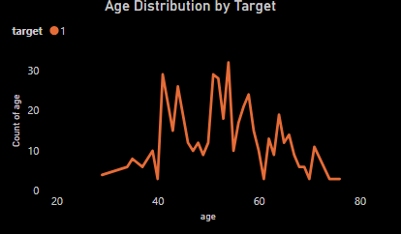
My Design
Visualization of Heart Disease Patients by age and sex

Slide 7
